Slide 1

ggPMX Efficient and Versatile R package for Pharmacometrics Model Diagnostic Plots
Irina Baltcheva, Bruno Bieth, Matthew Fidler, Souvik Bhattacharya
Notes:
BB – We will present today on behalf of the ggPMX team, currently composed of both of us, Andrzej, Matt and Souvik from Novartis. ggPMX is an open-source R package which we developed over the past years with the aim to provide to the Pharmacometrics community a model diagnostics toolbox that is efficient and versatile.

Slide 2





Who we are
Bruno Bieth, PhD
Irina Baltcheva, PhD
Matthew Fidler, PhD
Souvik Bhattacharya, PhD
Notes:
BB – presente team
IB - You may wonder what is the value of another package in addition to all the R packages we use in our daily work. To answer this, have a look at this picture....

Slide 3

Life before ggPMX
Notes:
BB - This is a possible reaction of a typical modeler that needs to write code for diagnostic plots BEFORE ggPMX.

Slide 4

Life before ggPMX
Life with ggPMX
Notes:
BB - No matter how comfortable you are with R, from time to time, you will have to figure out where is the bug in your piece of code or you have to deal with the frustration of spending more time than planned on writing the code.
The good news we have for you is that when you start using ggPMX, it is like having the gift from an Angel. It would save you tremendous amount of time in writing those line of codes.

Slide 5
Compatible with NONMEM, Monolix, and nlmixr
Consistent, reproducible and efficient workflow
Automated generation of PDF, Word or PNG outputs for reporting purpose
Advanced Features for customization and stratification
High quality graphics, ready-to-use in submission documents and publications
Notes:
IB – The beauty of ggPMX is that it is compatible with three of the most used non-linear mixed effect model fitting software, namely NONMEM, Monolix and nlmixr.
Actually, it all started with the internal Model building guidance. We realized that we have a gap in our workflow, because each of us has his/her own code for diagnostic plots and this creates inefficiencies in terms of validation. We therefore designed the package having in mind its cross-software compatibility and consistency.
A key feature of ggPMX is the automated generation of a diagnostics report. We also allowed for a lot of flexibility in terms of customization options. Finally, an important feature is the possibility to use it in for submission work or publications.

Slide 6
List of Diagnostic Plots
Section of modeling report | Description | HA
Main body | Normalized prediction distribution errors versus population predictions (NPD vs. PRED) | ✔
 | Normalized prediction discrepancies versus time (NPD vs. TIME) | ✔
 | Individual weighted residuals versus individual predictions (IWRES vs. IPRED) | ✔
 | Individual weighted residuals versus time (IWRES vs. TIME) | ✔
 | Visual predictive check (VPC) | ✔
Appendix | Distribution and quantile-quantile plot of IWRES | ✔
 | Distribution and correlation structure of estimated inter-individual random effects (ETA) | ✔
 | Relationships between estimated inter-individual random effects (ETA) and covariates | ✔
 | Observations and model predictions per individual (individual fits) | ✔
 | Observations versus population predictions (DV vs. PRED) | ✔
 | Observations versus individual predictions (DV vs. IPRED) | ✔
 | Absolute individual weighted residuals versus individual predictions (|IWRES| vs. IPRED) | ✔
Notes:
IB – When we think of diagnostics plots, we all know that to assess the robustness of your model, you need to rely on a wide range of figures, such as NPDE vs PRED, NPD vs TIME, etc. Ultimately, you’ll need to generate a long list of plots for each model, coming with numerous lines of code.
Here is an extract of the model building guidance, from the section on modeling report: This suggests where to place the different plots, either in the main body or the appendix of the modeling report. It should not be seen as a strict rule; we want to emphasize content (i.e. the overall package of diagnostics that we consider essential for model evaluation) rather than where they should go in the report.

Slide 7
ggPMX - Intuitive & Fast Comprehensive model diagnostics report with two lines of code
library(ggPMX)
Controller Creation
ctr <- pmx_nm(directory = nonmem_dir_path,
file = “my_nonmem_run.lst")
NONMEM
ctr <- pmx_mlxtran(file_name = mlxtran_path)
Monolix
ctr <- pmx_nlmxir(fit)
nlmixr
Report Generation
ctr %>% pmx_report(name = "ggPMX_Report",
save_dir = "working_directory“,
format = "report", extension = "word")
Notes:
BB – with ggPMX, you’ll be asked to only type two lines of code to generate the extensive list of diagnostic plots you have seen previously! First need to create a ggPMX controller, an object containing all required information to generate the figure. Done in different manner depending of the modeling software: NONMEM: on the control file, Monolix, on the mlxtran file, nlmixr on a object produced by nlmixr fiiting. After that, need to execute the generate a document listing all plots using pmx_report

Slide 8
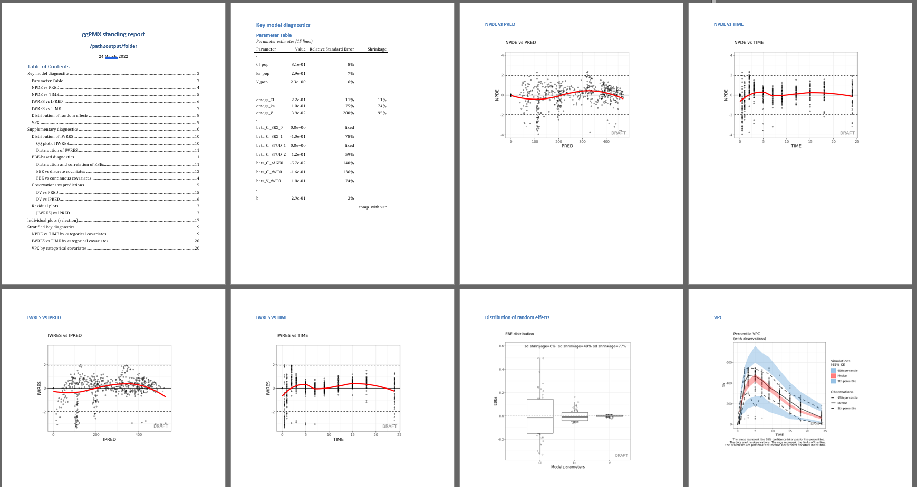
Notes:
BB – As an example, we have done a screen shot of the report for you... Word document with table of content – one figure per page, NPDE vs time, distribution of RE. VPC

Slide 9
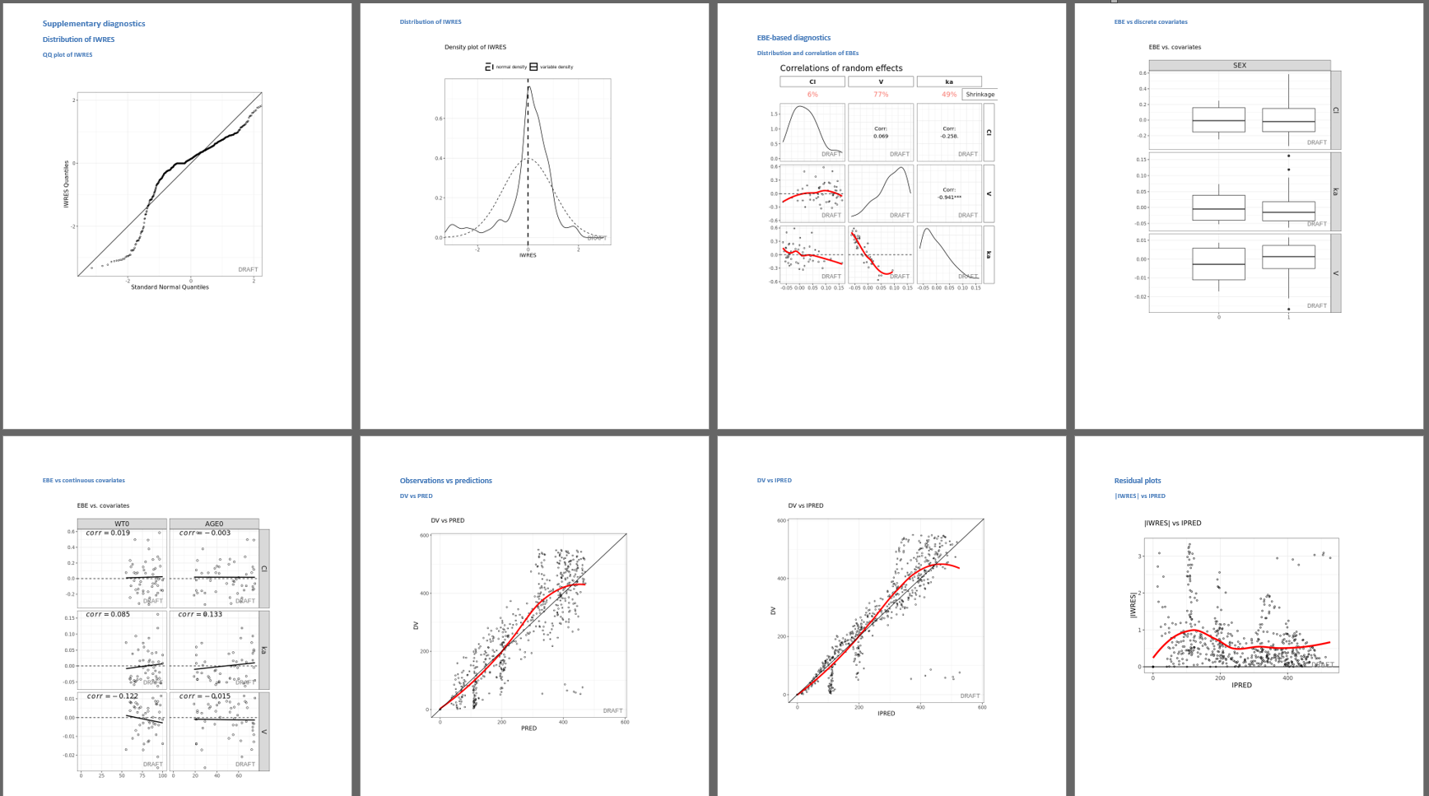
Notes:
BB - Correlation of random effect, distribution of RE according to categorical or continuous covariates, individual fits

Slide 10
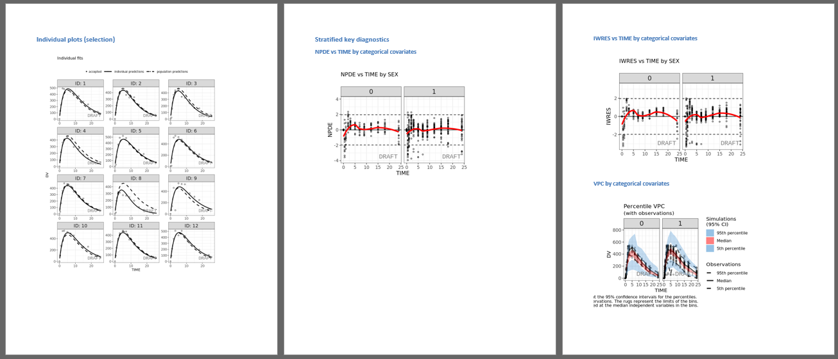
Notes:
BB- last page contained all additional stratifical you have identified deemed necessary in evaluation the robustness of your model building

Slide 11
Software-Specific Requirements
NONMEM
Version ≥ 7.2
Same output table setting as xpose
Monolix
Version ≥ 2016
Run at least the following Monolix tasks:
Population Parameters
EBEs
Standard errors
Plots
Export Chart data
Select at least the following plots to be displayed and saved:
individual fits and
scatter plot of the residuals
nlmixr/nlmixr2
nlmixr > 2.0 for censoring support
nlmixr output object
Note: VPC of ggPMX with nlmixr currently not working
Notes:
BB– Because this library has been developed over the past years, there are some requirements in terms of modeling software versions. : you need to use version later than 7.2 in NONMEM. For Monolix version later than 2016 and perform some specific tasks to retrieve the data related to diagnostics plots

Slide 12
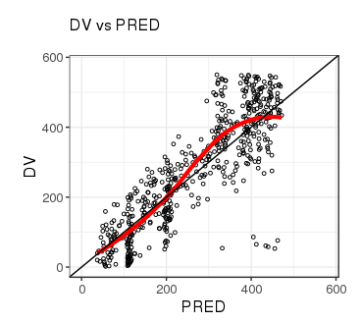
Single Plot Functions
Plots visualized using the functions pmx_plot_xx(), where xx is a placeholder for the plot name. First argument is always the controller (use piping!)
Example:
ctr %>% pmx_plot_dv_pred()
ctr %>% pmx_plot_npde_time()
ctr %>% pmx_plot_eta_box()
ctr %>% pmx_plot_eta_matrix()
ctr %>% pmx_plot_individual()
ctr %>% pmx_plot_vpc()
Notes:
IB- A diagnostic report in ggPMX is nothing but a series of single plot commands. You have the possibility to access and generate yourself each individual plot without creating a report. We have given a few examples of various diagnostics. You use the controller to call the single plot functions using the syntax pmx_plot_nameoftheplot(). These commands without additional arguments will create plots with the default settings.

Slide 13
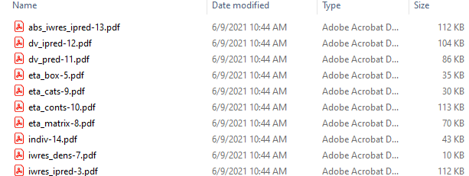
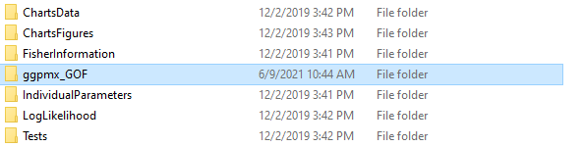
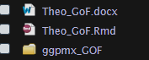
Generating a Diagnostics Report: pmx_report()
3 report formats available (word, pdf, html) – by default, Word document (only) is generated
Possibility to create a folder containing all figures (format = "both"), saved as individual files:
ctr %>% pmx_report( name = "Report_ggPMX", # Report Filename
save_dir = "work_dir", # Directory Path to Report
format = "report", # Create just a report
extension= "word") # Report Format
Notes:
IB – Now, a little more details on how to create a diagnostics report. You have the choice of 3 report formats: word, pdf or html.
Again, using the controller, you simply call the function pmx_report where you need to specify at least four arguments:
name of your report,
the folder where you want to save it and
the type of document you want to generate (word in the example code). Alternatively, you can also create a pdf or html report file.
You also have the option to create a folder containing all plots as separate documents as displayed in the provided screenshot by using the option format = report. The ggpmx_GOF folder is actually very useful when you need to refer to a specific individual figure in a submission document.

Slide 14
Key features
Graphical customization
Multiple endpoints
Stratification and filtering
VPC
Censoring
Shrinkage
Parameter table
Notes:
BB – In the remaining few slides, we will go through some of the key features of ggPMX: multiple endpoints, stratification, etc.

Slide 15
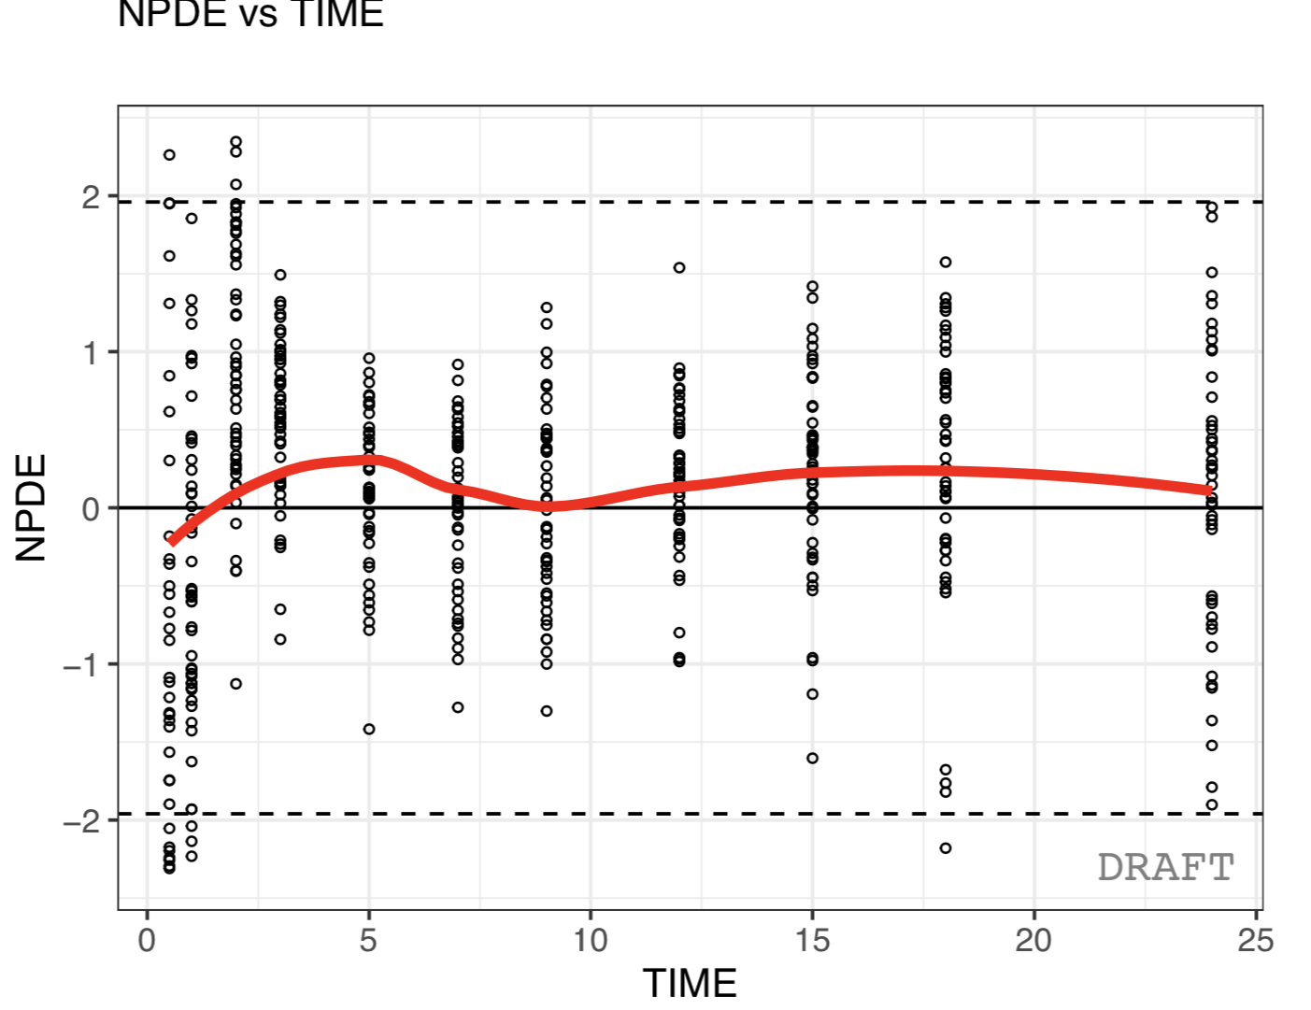
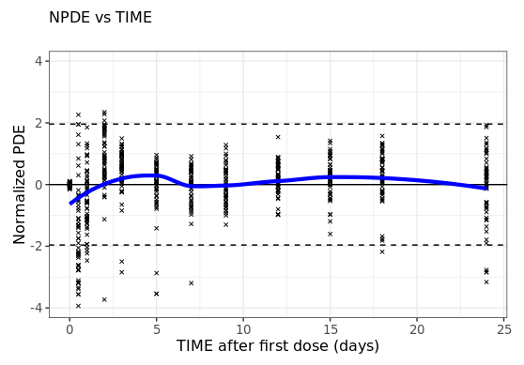
Plots customization – on the fly
Default setting
Updating labels and graphical settings
ctr %>% pmx_plot_npde_time()
ctr %>% pmx_plot_npde_time(
smooth = list(color = "blue"),
point = list(shape = 4),
is.draft = FALSE,
labels = list(x = "TIME after first dose (days)",
y = "Normalized PDE"))
Notes:
IB – The default settings are critical for the success of any package. We made sure that the default setting is good enough, but if you’re not happy with the them, you have the possibility to customize the figures yourself, in a similar way as you would go with ggplot. On the lefthand side, you have the default call to the npde vs time graph. On the right, you have the graph where we changed a few graphical parameters.

Slide 16
Multiple endpoint models
ggPMX produces one diagnostics report per endpoint
The endpoint is defined within the controller:
to filter the observations dataset
to keep only the values corresponding to the endpoint of interest
One report per endpoint, e.g. one pmx_report per controller
# Controller Creation for PD data (DVID==2)
ctrPD <- pmx_nm(directory = work_dir, dv = "DVID", endpoint = 2)
ctrPD %>% pmx_report( name = "Report_ggPMX_PD",# Report Filename
save_dir = "work_dir", # Directory Path to Report
format = "report", # Report Setting
extension= "word") # Report Format
Notes:
BB – The way ggPMX works is that ggPMX generates one report per endpoint. It means that if you work with several endpoints, each time you create a controller, you need to create it accordingly to the endpoint of interest, In this exemaple the PB endpoint is captured in the column label DVID equal to 2. Once the controller is created, you retrieve the corresponding report capturing all Gof for this endpoint.

Slide 17
VPC – Controller creation
User needs to provide a simulation dataset at the controller creation
Use your preferred simulation software/package to create the simulation dataset containing (at least) the following columns:
ID: individual identifiers
REP: simulation replicate number
TIME: time
DV: dependent variable
Create a “simulation object” using pmx_sim() and pass it as an argument of the controller function
Example:
# Enable VPC functionality for a Monolix controller
ctr <- pmx_mlxtran(file_name = mlxtran_path,
sim = pmx_sim(file = "sim.csv", irun ="REP", idv="TIME"))
Notes:
IB - Now, we would like to give you some information on the VPC functionality. To enable it, you need to provide a simulation dataset when you create the controller. You can use your preferred simulation software to create this dataset and save it in a file. The dataset should contain at least the four columns listed here.
Once you have your simulation dataset, you need to use the sim argument of the controller function to create a pmx_sim object that will allow displaying the VPC graph. The example here shows the syntax with a Monolix controller, but it’s applicable in the same way for NONMEM and nlmixr controllers.

Slide 18
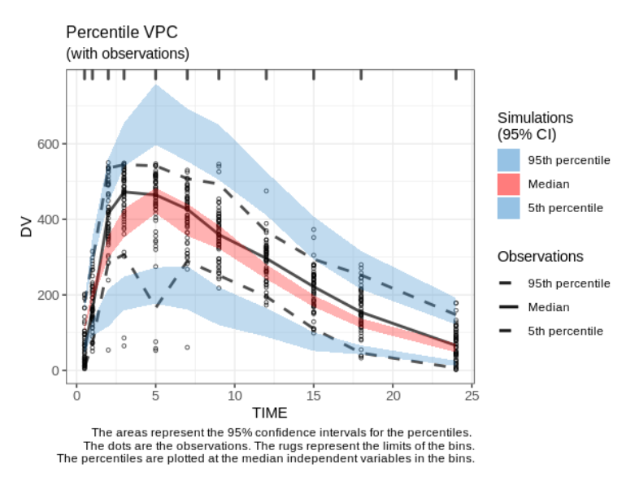
VPC - Default setting
ctr %>% pmx_plot_vpc()
Legend automatically updated when statistical summaries are changed
Notes:
IB - Once you have enabled the VPC functionality via the controller, you can view the graph by using the pmx_plot_vpc function. Here is the default look of the VPC plot for a model fitted on a small dataset from a single study.
To make the figure self-explanatory, we added by default a legend and footnote. Both are adjusted automatically: whenever you change some of the VPC settings like the confidence level, the legend and footnote are adjusted accordingly.
The default VPC setting works fine for this simple example. However, in real-life situations, it will often be the case that you will need to adjust the binning. The next slide illustrates how to change the binning method.

Slide 19
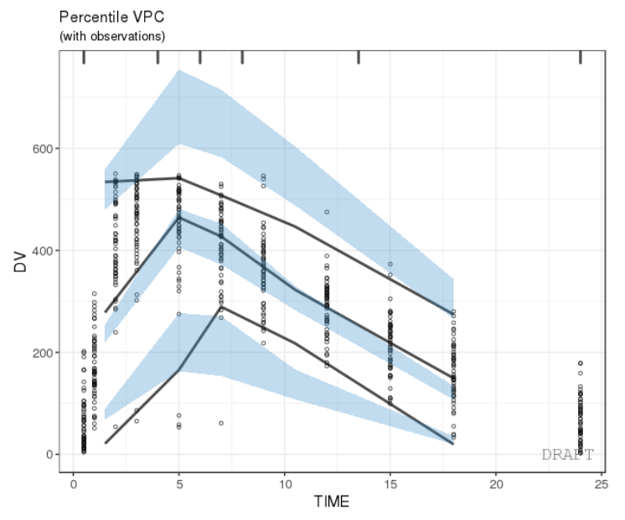
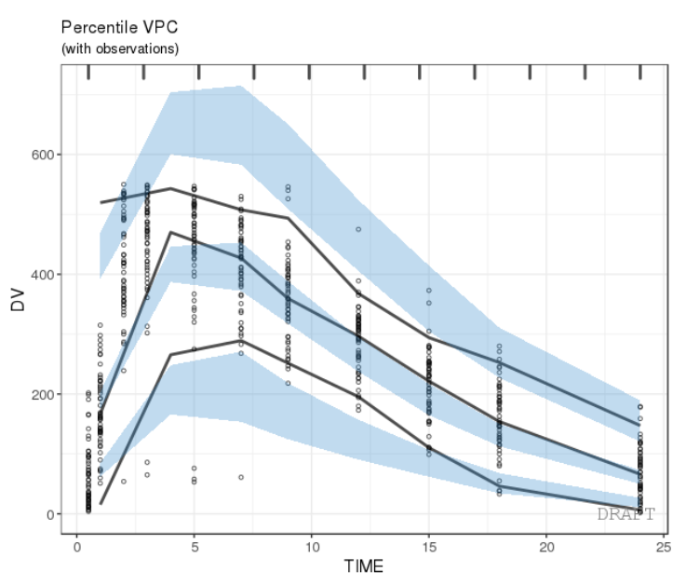
VPC – change the bins
1.
2.
ctr %>% pmx_plot_vpc(bin = pmx_vpc_bin(style = "kmeans", n=5))
ctr %>% pmx_plot_vpc(bin = pmx_vpc_bin(style = "equal", n=10))
1.
2.
Package classInt is used for binning
Various binning methods available (fixed, sd, equal, pretty, quantile, kmeans, hclust or jenks)
Notes:
IB – The binning is changed by using the bin argument and the pmx_vpc_bin function.
Note that ggPMX uses the package classInt to handle the binning. This package contains a few different binning methods listed here, some of them requiring additional parameters.
You see in these two graphs the VPC of the simple model with two different binning styles. Bins are indicated by the rugs. On the left, we used kmeans with 5 bins. On the right, we used 10 equal-size bins.

Slide 20
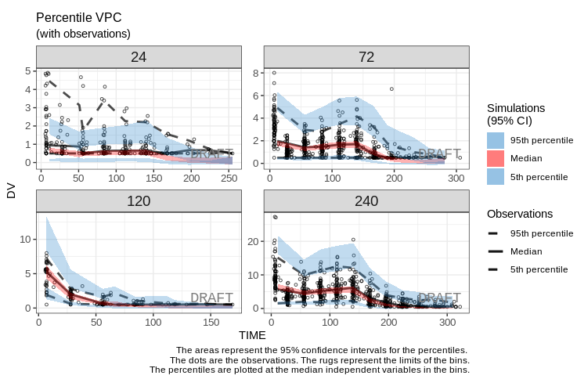
VPC - stratification
ctr %>% pmx_plot_vpc(bin = pmx_vpc_bin(style = "equal"),
strat.facet = "DOSE",
facets = list(scales = "free"))
Notes:
IB – Finally, we would like to give you a flavor of how graphs can be stratified. Our first example shows how to stratify the VPC.
This feature is particularly important for the VPC graph, especially when you’re working with large datasets that pool data from different studies. In such cases, the only way to have a meaningful VPC is to stratify at least by study in order to have an appropriate binning for each design.
In this example, we have stratified the VPC by dose by using the strat.facet argument of pmx_plot_vpc. Additionally, we have specified that the scales of each facet can be different. Note that as expected, statistics are calculated within each strata.

Slide 21
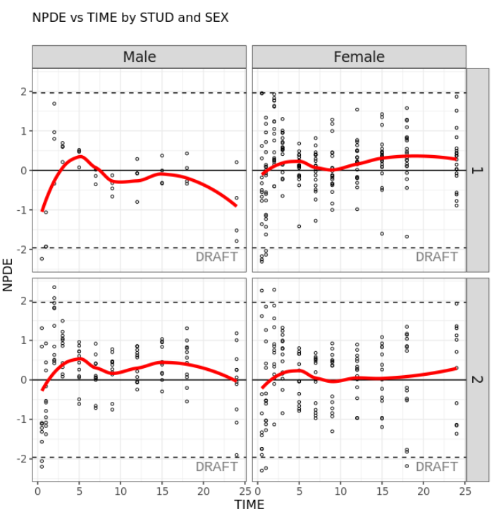
Stratification
Using arguments strat.facet (discrete) or strat.color (continuous) in pmx_plot_xxx().
Allows two-dimentional stratification
ctr %>% pmx_plot_npde_time(strat.facet = STUD~SEX)
Notes:
IB – Our final example is stratification of other diagnostic plots. Stratification is done using the arguments strat.facet (for discrete strata) or strat.color (for continuous strata) applicable to all pmx plot functions. One- or two-dimensional stratifications are possible. In this example, the NPDE vs TIME plot is stratified according to STUDY and SEX. You get a result in the style of facet.grid of ggplot. The smoothing is of course done within each strata.

Slide 22
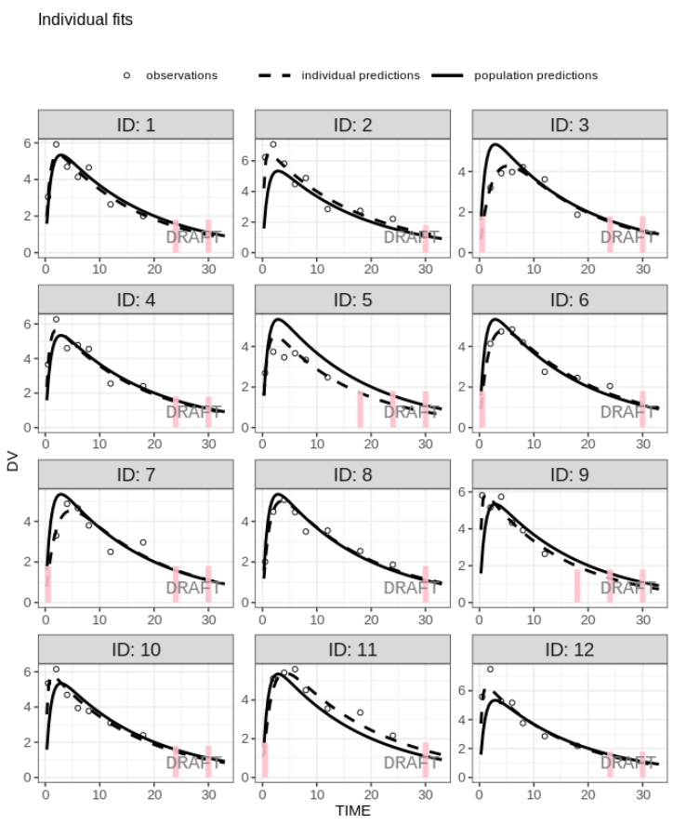
Censored data
Create controller with BLOQ* data (BLQ column in input dataset):
ctr <- pmx_mlxtran(
file_name=mlx_file,
bloq = pmx_bloq(cens = "BLQ"))
ctr %>% pmx_plot_individual()
Works similarly with ULOQ** data.
*BLOQ: below limit of quantification
**ULOQ: upper limit of quantification
Notes:
IB – range of censored data, as in Monolix and it will apply to all individual plots no matter the software.
Will also apply to other GoFs.

Slide 23
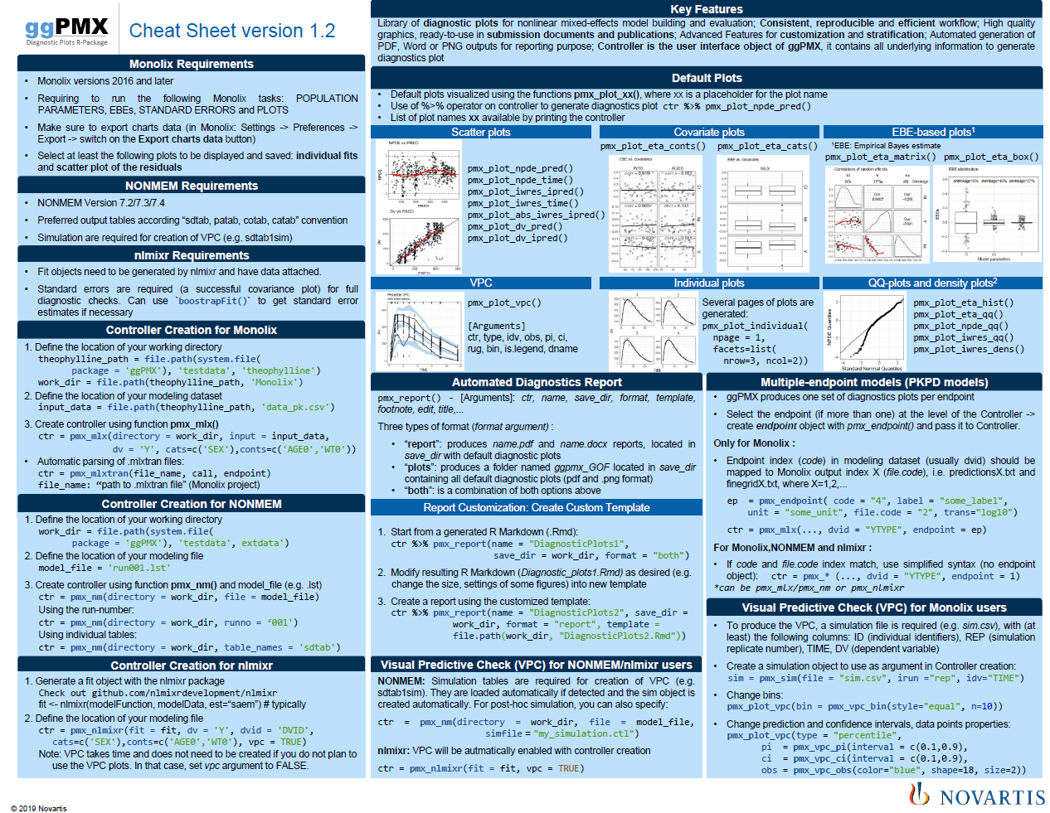
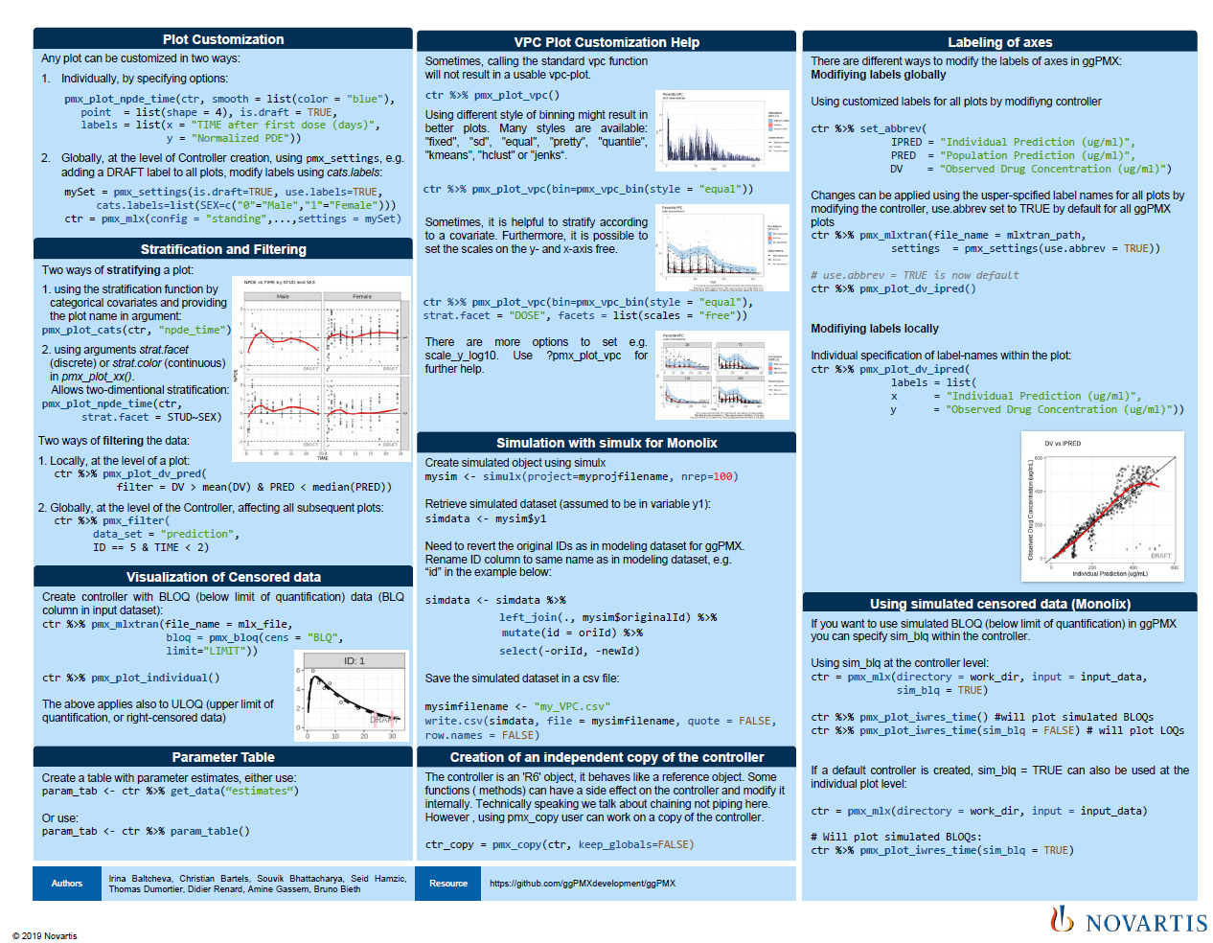
Cheat Sheet
Notes:
BB – Like in any R package that comes from Rstudio, we put a lot of effort in creating 2 pages Cheatsheet that captures the key features of the package. It means that as a new user of the package, and having the cheat sheet on your side, you will be able to use straightforward the package

Slide 24

Documentation & Help
Latest ggPMX version available on GitHub and CRAN
Documentation & Training Material on Github
https://github.com/ggPMXdevelopment/ggPMX
Vignette (User Guide)
Notes:
IB
Comprehensive vignette

